Slide 1



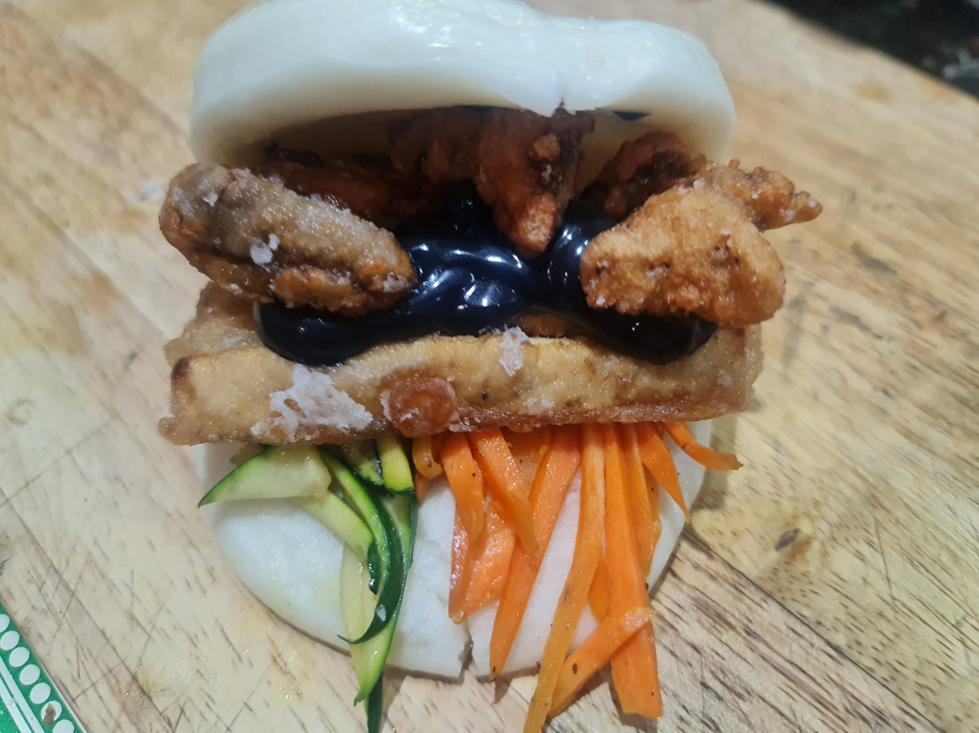





About Me
Name: Dhilan Thiyagarajah
From: Croydon
Hobbies: Gaming, Foodie
Degree: Chemistry with Biochemistry
github.com/Dhilan100
linkedin.com/in/dhilan-thiyagarajah-4469a612b/
public.tableau.com/app/profile/dhilan.thiyagarajah7885/vizzes
instagram.com/dhilan.traj
Notes:
my drive to progress my knowledge through continuous learning.
Soft skills like critical thinking and adaptability
process real world data, from managing patient information in trust db
Communicating study data and using excel to see trends for Covid detection rates
I been exposed to data, early on through my love for gaming.
When I not thinking about data I enjoy cooking and presenting visually appealing dishes
progress a data career in industries like Healthcare and Entertainment
These links on the side showcase my work but will be provided at the end so on to the presentation

Slide 2
Winning through Data
Demonstrating the power of data analysis in Pokemon
Notes:
the things I enjoy with the things I learnt in the bootcamp.
how data analysis can help gain an advantage in games like Pokemon

Slide 3


What are Pokemon?
Winning through Data
Pokemon are virtual monsters
The most popular franchise since 1997 and it is still growing!
Aim of the games is to catch and battle
The winner of the battle gets glory and prize money
Demonstrating the power of data analysis in Pokemon
Notes:
Also know as pocket monsters and have been in the world of pokemon since 1997
Aim of the game is to Catch, Train, Evolve and ultimately battle trainer to win glory and prize money

Slide 4
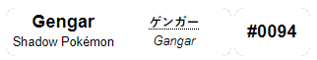

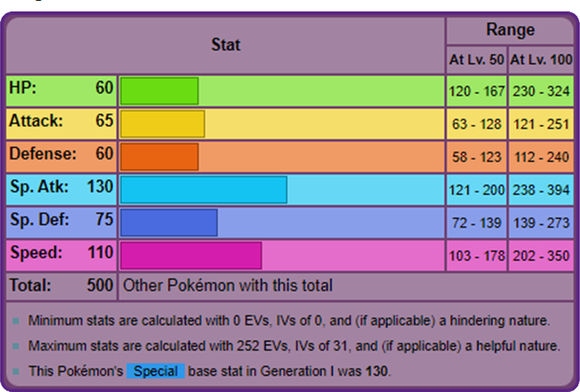
Pokemon Attribute Statistics
Each Pokemon have a mix of attributes that make them unique/standout
For competitive battles strategies are formed based on the stats of a Pokemon
The total stat can indicate how strong a pokemon is overall.
For analysis data was retrieved from Kaggle and Tableau website
I should think about safe guarding data
Tableau to show visualising the data for seeing trends for analysis.
Notes:
Each pokemon have a unique set of attributes
For my analysis I used pokemon data from both Kaggle and Tableau
When handling data I must ensure data safeguarding to prevent misuse and follow GDPR
I ended up using Tableau as I preferred it to visualise data and see trends

Slide 5
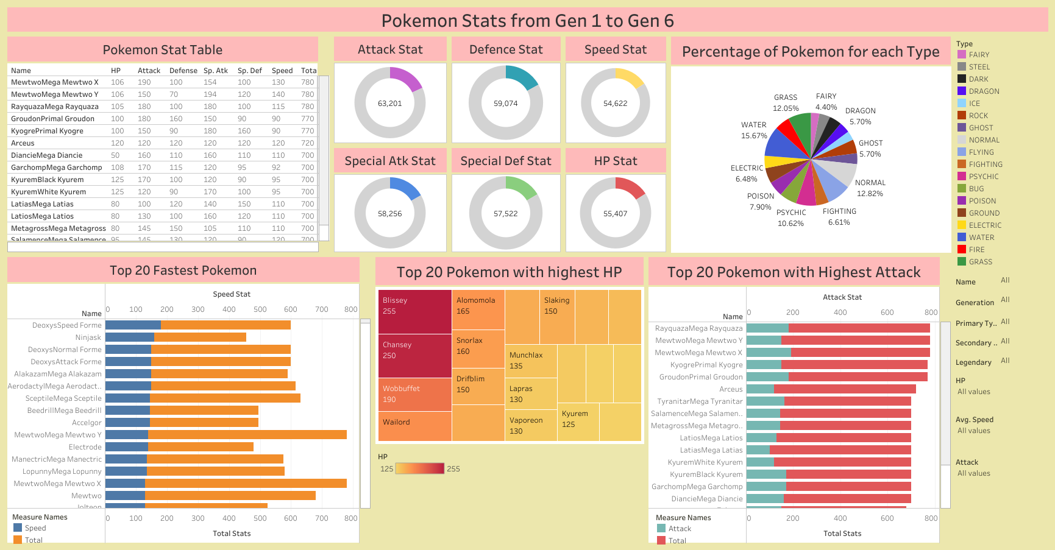
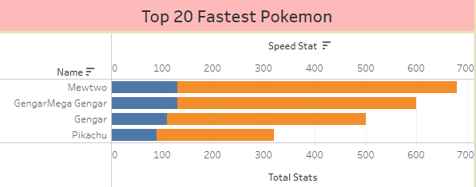
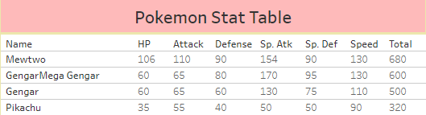
Generating Tableau
Dashboard
Made a relationship with two sets of Pokemon Data
Created Multiple charts for different stats
Filters help dynamically display data
When comparing select few Pokemon you can see differences in stats
Gengar is as nearly as the top tier Legendary Pokemon.
Speed stat to keep up the tempo of the match
Special Attack to power up special moves
The power of data analysis to tell a story
Notes:
As you can see using the bar chart Pikachu’s speed stats and total stats lag behind Gengar and Mewtwo.
When using the stat table I can see that Mewtwo is the strongest of the three with a total stat of 680
But when I mega evolve Gengar I can match mewtwo’s speed of 130 and out damage using the special stat of 170
Gengar’s defenses are still lower so will lose if it gets hit
In conclusion I would Mewtwo when forming a team to come up with a strategy but if legendaries are banned I would use Gengar to mega evolve so I can keep up with tempo and hit hard.
So using Tableau I was able to come up with solutions to problems I am presented with by picking up on trends from visual data.

Slide 6
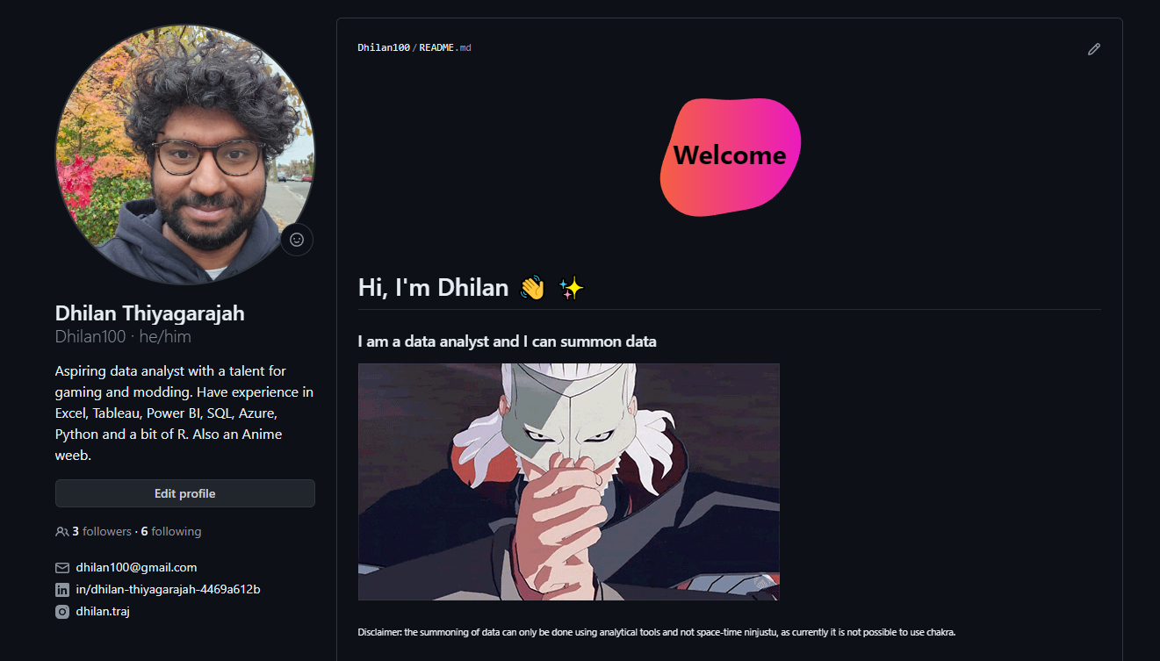
Thank You
Everyone!
github.com/Dhilan100
linkedin.com/in/dhilan-thiyagarajah-4469a612b/
public.tableau.com/app/profile/dhilan.thiyagarajah7885/vizzes
instagram.com/dhilan.traj
Notes:
I like to end this presentation by
Thank you to JustIT for giving me this opportunity to learn
Thank you to Yusuf for teaching me how to be a data analyst
Thank you to Leigh for giving me the soft skills required to present myself as a data analyst
and finally Thank you to everyone in the cohort for making the bootcamp fun and enjoyable.
If anyone is interested my work on the projects I do the links are to your left and you can also contact leigh to connect with me
Thank you

